Slide 1



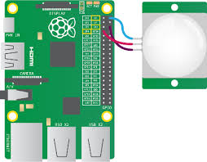
Text-Intruders.pi
By: Cassey Waldo, Derrick Palmore, & Farha Idriss
An intruder alarm that sends a text message warning to the owner of a smartphone device with text messaging (SMS) capabilities.
https://github.com/ksu-is/Text-Intruders.pi

